Slide 1
Git

Slide 2
Git Journey
Week 1
Week 2
Week 3
Git introduction Git workflow
Local repo operations
Github repo
GUI
Branches
Merge & Conflicts
Distribution models
Branching Strategies

Slide 3
Git
Version Control Systems
What comes to you your mind when you hear this?
Notes:
🍐 This is a Pear Deck Text Slide
🍐 To edit the type of question, go back to the "Ask Students a Question" in the Pear Deck sidebar.
Do you think it’s necessary to use git even when a single developer exists in the project?

Slide 4

Where are we about Git?
Let’s discuss about Git
Notes:
Who used it up to which point?
Did you resolve any conflicts?
Did you contribute to any open source project?

Slide 5



Did you finish pre-class work?
Notes:
Hard or Easy
Use this template to do a quick temperature check and self-reflection about the homework. You can learn which students might have struggled with the assignment and therefore might need more attention today.
🍐 This is a Pear Deck Draggable™ Slide.
🍐 To edit the type of question, go back to the "Ask Students a Question" in the Pear Deck sidebar.

Slide 6
Objectives
Understand version control
Familiarize Git terminology
How to create a git repository
Understand Git commands
Understand Git workflow
Notes:
Version Control :
Version control enables multiple developers simultaneously work on a single project. Each person edits his or her own copy of the files and chooses when to share those changes with the rest of the team. Thus, temporary or partial edits by one person do not interfere with another person's work.
Git Terminology :
Working tree : Changes made in a project, working tree keeps the current state of files and folders.(Excluding the git folder)
An index (Staging Area) : It is like a snapshot of your working tree that contains all the current changes. Simply speaking, it’s a large file inside the .git folder which contains all your files and their checksums.
Commit : When we perform a commit, the created snapshot is added to the project history. You can browse the created commits and even restore the previous versions of the files.
Branch : It is like an independent version of the same project stored in the same folder. You can switch between these independent versions, make changes as necessary, and at some point merge two versions together (or delete one of the versions completely). As the Git book says, “Branching means you diverge from the main line of development and continue to do work without messing with that main line”.
File States :
Untracked — a new file was added to the working tree but it’s not tracked by Git yet. You can start to track it by using git add command (see below).
Modified — the changes were made in the working tree but not yet staged for commit (in other words, these changes are not added to the current index).
Staged — the changes were added to the index. This way, they will become a part of the next commit.
Commited — the changes were added to the project history as a part of a commit. All commits are stored in the .git folder.
Git Commands :
git init : Init-Reinit a repository : git init -b primary
git status
git add
git commit
git push/pull
git stash
git log
git branch
git checkout
git merge

Slide 7
Version Control Systems let us to;
Track changes on files (text / source code files) for you
Unlimited Undo / Redo
Time Travel
Collaborative development environment
Compare and Share Responsibility
What changed
When it changed
Why it changed
Who changed it

Slide 8
Why do we need Git?
Backup/Archive/Versioning/History
Undo Changes
Comparing
Collaboration and Teamwork
Code Review
Sharing Responsibility

Slide 9
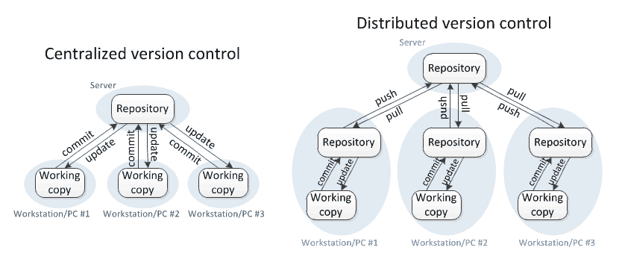
Version Control Systems
Types
Distributed
Centralized (Client-Server)
Notes:
Centralized :
You basically get the files from a server and when you’re finished you’re uploading to the server. One example is SVN.
It’s of course better than saving manually your files in your computer and more secure definitely.
There are some restrictions
you must be connected to the server
you don’t have a full copy of the project (something happens you cannot reach your files)
Distributed :
You need to get connected to the server only when you need to upload or download your files.

Slide 10
Git
Git is an open source distributed version control system
Notes:
The source code of git itself can be found on the link :
https://github.com/git

Slide 11
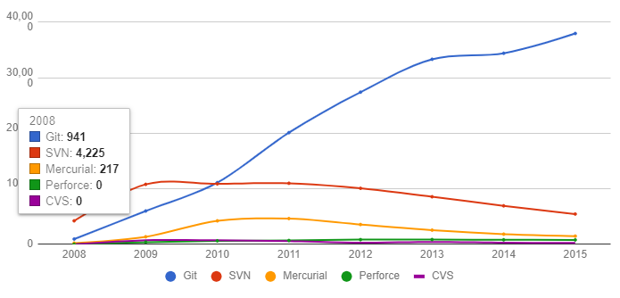
Popularity

Slide 12


Git Repository
Notes:
Git repository is basically the project folder.
It contains all the files including the .git folder inside.
Its hidden not visible by default.

Slide 13
Git
The Workflow

Slide 14
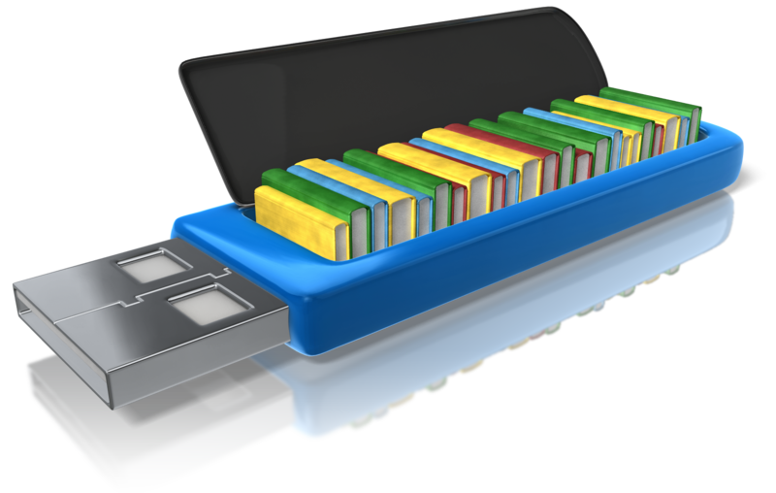
Workflow
Working Directory Staging Area (Index) Repository
Where you work.Create new files, edit files delete files etc.
Before taking a snapshot, you’re taking the files to a stage. Prepare the files to be committed.
Committed snapshots of your project will be stored here with a full version history.

Slide 15
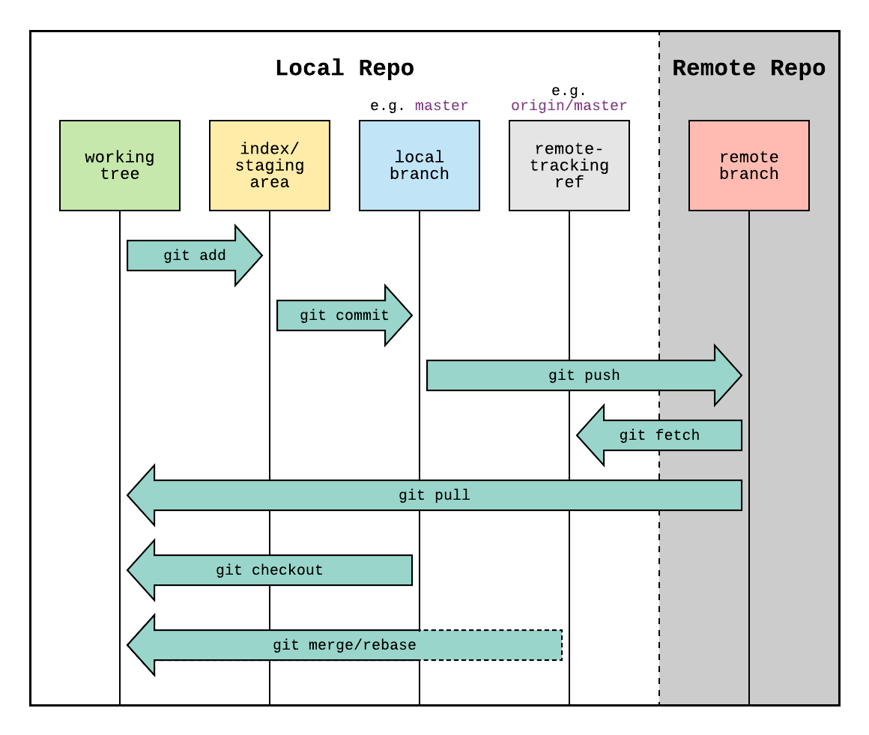
Git Workflow
Notes:
Which folder is the local repository? Is it stored in a local db?
How many repositories are there in local? (As much as added folders)
Until you push them to the remote, all the changes are kept local.

Slide 16
File Stages
Committed
Unmodified changes from the last commit snapshot
Modified
Changes made to files since last commit snapshot
Staged
Changes marked to be added into the next commit snapshot

Slide 17
Create a new file
Working Directory Staging Area (Index) Repository
Maps.html
untracked file

Slide 18
Track/stage a file
Working Directory Staging Area (Index) Repository
Maps.html
Maps.html
git add

Slide 19
Commit
Working Directory Staging Area (Index) Repository
Maps.html
Maps.html
Maps.html
git commit -m

Slide 20
Commit
Working Directory Staging Area (Index) Repository
Maps.html
Maps.html
Maps.html
git commit -m
git log t
Master

Slide 21
Remove from stage
Working Directory Staging Area (Index) Repository
Maps.html
NewMaps.html
Maps.html
NewMaps.html
git rm --cached
git restore --staged

Slide 22
Checkout from Repo
Working Directory Staging Area (Index) Repository
Maps.html
NewMaps.html
Maps.html
NewMaps.html
Maps.html
NewMaps.html
git checkout

Slide 23
Git User interface tools
GitHub Desktop
GitKraken
Sourcetree
Tortoise Git
SmartGit
GitForce
Git Cola
Aurees
Magit
Fork
Since we have the UI tools, why do we need to know CLI (Gitbash) commands?
Notes:
GitKraken seems to have a trial for 7 days.
Tortoise has SVN as well.

Slide 24
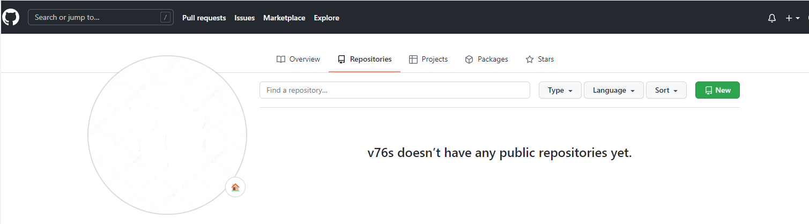
GitHub

Slide 25
Some Git bash commands
git –version
git init
git status
git add
git remote add
git commit
git push
git pull
git merge
git log
git branch
git checkout
Notes:
git --version
git init
Creates the git hidden folders files.
git status
Displays the current branch name.
git status -s // Display output in short format.
git status -b // Show the branch and tracking info in short format.
git status -v // verbose output
git add .
It updates the index with the content found in working tree. Index is like a snapshot of the current working tree.
git add . Its possible to add selected files only as well.
git remote add origin https://github.com/v76s/GoogleMaps.git
this command creates a pointer to the repository. This repository has an alias "origin" but anything could be called.
git commit
git commit -m "The initial state"
git commit -am "The initial state" // Automatically stage and commit.
git push origin master
its also possible to use git push -u origin master (upstream)
so it's not needed to tell origin anymore.
git push
it is now applicable to tell git push after -u option provided.
git push origin another_branch
it is possible to push it to another branch as well.
git pull origin master
retrieve the latest state of the repository
git merge
When the conflicts occur, it will be necessary to merge them.
git log
Displays the complete commit logs, who did what changes.
git branch
Displays the complete list of branches.
git checkout BRANCH_NAME
Switch to another branch
git init
git add README.md
git commit -m "first commit"
git branch -M main
git remote add origin https://github.com/v76s/GoogleMaps.git
git push -u origin main
git config user.name

Slide 26
Git Repository
Let’s check if you have git in your computer
git --version t
git needs your identity to mark/label changes / editor
git config --global user.name “Your Name” t
git config --global user.email “Your Name” t
git config --global core.editor “vim” t
git config --list t
Notes:
For different repositories if you like to define different username or email use the command without global option.
git config user.name

Slide 27
Track a new file
let’s create a new file in our project folder
touch Maps.html
let’s edit this file
vim Maps.html t
let’s check the status of our project
git status t

Slide 28
Git Repository
to create a new local repo
git init t
to see the commands
git t
to see the status of your repo
git status t
Notes:
Let’s see what it looks like?
Let’s start playing with Git.
Windows powershell / gitbash
Mac terminal
Let’s create a folder on Desktop for convenience. my-projects
mkdir my-projects
What happened
to see what happened let’s go to project folder
It’s nothing but so many folders and files.
hidden files
To delete your repository, just delete the folder.

Slide 29
Git Repository
to create a new remote repo and connect it with your local repo (after you create a remote repo on Github/Bitbucket etc.)
git clone address t
Notes:
We’re going to see remote repo operations on the next session.
just fyi.

Slide 30
Stage files options
stage one file
git add filename t
stage all files (new, modified)
git add . t
stage all changes
git add -A t
stage modified and deleted files only
git add -u t

Slide 31
Commit
Commit the files on the stage
git commit -m ”message” t
Add and commit all tracked files
git commit -am ”message” t
amend commit message
git commit --ammend t
Notes:
Commit often
Write clear commit messages

Slide 32
Recipe for a new project
Create a repo git init t
Create a new file/edit file etc.
Stage/Track your changes git add . t
Commit changes git commit -m “message”t

Slide 33

THANKS!
Any questions?
You can find me at:
@volkan
volkan@clarusway.com

Slide 34
Git Session2
Notes:
The git conflict resolving material is not completed.

Slide 35
Objectives
Review the prior command set
Familiarize Github features and UI
Git Desktop install and use
GitKraken UI introduction
Notes:
Version Control :
Version control enables multiple developers simultaneously work on a single project. Each person edits his or her own copy of the files and chooses when to share those changes with the rest of the team. Thus, temporary or partial edits by one person do not interfere with another person's work.
Git Terminology :
Working tree : Changes made in a project, working tree keeps the current state of files and folders.(Excluding the git folder)
An index (Staging Area) : It is like a snapshot of your working tree that contains all the current changes. Simply speaking, it’s a large file inside the .git folder which contains all your files and their checksums.
Commit : When we perform a commit, the created snapshot is added to the project history. You can browse the created commits and even restore the previous versions of the files.
Branch : It is like an independent version of the same project stored in the same folder. You can switch between these independent versions, make changes as necessary, and at some point merge two versions together (or delete one of the versions completely). As the Git book says, “Branching means you diverge from the main line of development and continue to do work without messing with that main line”.
File States :
Untracked — a new file was added to the working tree but it’s not tracked by Git yet. You can start to track it by using git add command (see below).
Modified — the changes were made in the working tree but not yet staged for commit (in other words, these changes are not added to the current index).
Staged — the changes were added to the index. This way, they will become a part of the next commit.
Commited — the changes were added to the project history as a part of a commit. All commits are stored in the .git folder.
Git Commands :
git init : Init-Reinit a repository : git init -b primary
git status
git add
git commit
git push/pull
git stash
git log
git branch
git checkout
git merge

Slide 36
Review Commands 1
git version
git init
git status
git add .
git remote add (Alias) https://github.com/(Account)/(Repo).git
git commit
git push (Alias) (Repository)
git push
Notes:
Version Control :
Version control enables multiple developers simultaneously work on a single project. Each person edits his or her own copy of the files and chooses when to share those changes with the rest of the team. Thus, temporary or partial edits by one person do not interfere with another person's work.
Git Terminology :
Working tree : Changes made in a project, working tree keeps the current state of files and folders.(Excluding the git folder)
An index (Staging Area) : It is like a snapshot of your working tree that contains all the current changes. Simply speaking, it’s a large file inside the .git folder which contains all your files and their checksums.
Commit : When we perform a commit, the created snapshot is added to the project history. You can browse the created commits and even restore the previous versions of the files.
Branch : It is like an independent version of the same project stored in the same folder. You can switch between these independent versions, make changes as necessary, and at some point merge two versions together (or delete one of the versions completely). As the Git book says, “Branching means you diverge from the main line of development and continue to do work without messing with that main line”.
File States :
Untracked — a new file was added to the working tree but it’s not tracked by Git yet. You can start to track it by using git add command (see below).
Modified — the changes were made in the working tree but not yet staged for commit (in other words, these changes are not added to the current index).
Staged — the changes were added to the index. This way, they will become a part of the next commit.
Commited — the changes were added to the project history as a part of a commit. All commits are stored in the .git folder.
Git Commands :
git init : Init-Reinit a repository : git init -b primary
git status
git add
git commit
git push/pull
git stash
git log
git branch
git checkout
git merge

Slide 37
Review Commands 2
update the Maps.html contents with a comment
and execute git pull to receive the updates.

Slide 38
Review Commands 3
Perform several times the enlisted commands :
Create a repository in Github.
Notes:
git push origin master
init
version
status
add
git remote add origin https://github.com,
git commit
git push origin master
git push
git clone workout

Slide 39
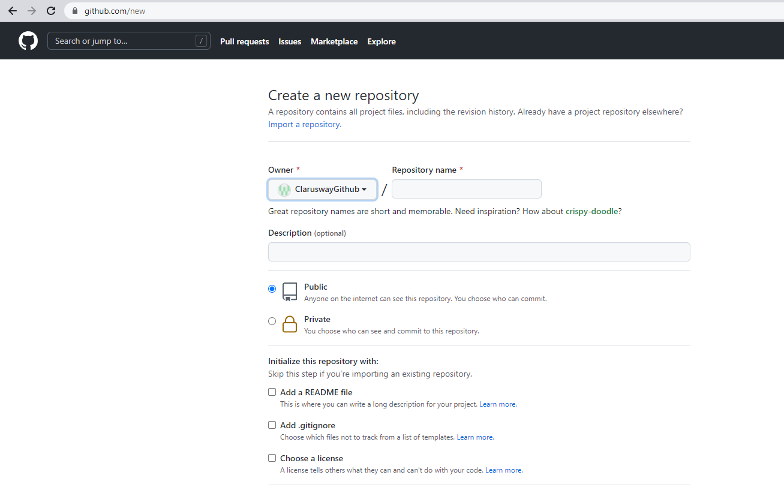
GitHub interface
Notes:
How to create a new repository

Slide 40
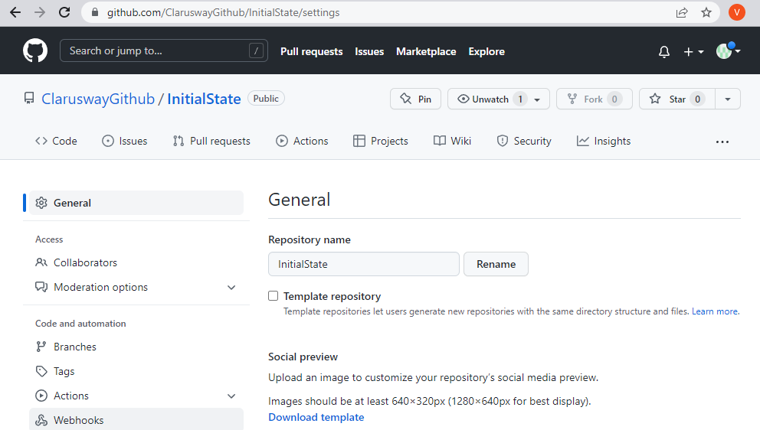
GitHub interface
Notes:
How to delete an existing Repository
and other interface details such as Github API and etc.

Slide 41
GitHub Desktop
https://desktop.github.com/
Notes:
Installation of Github Desktop

Slide 42
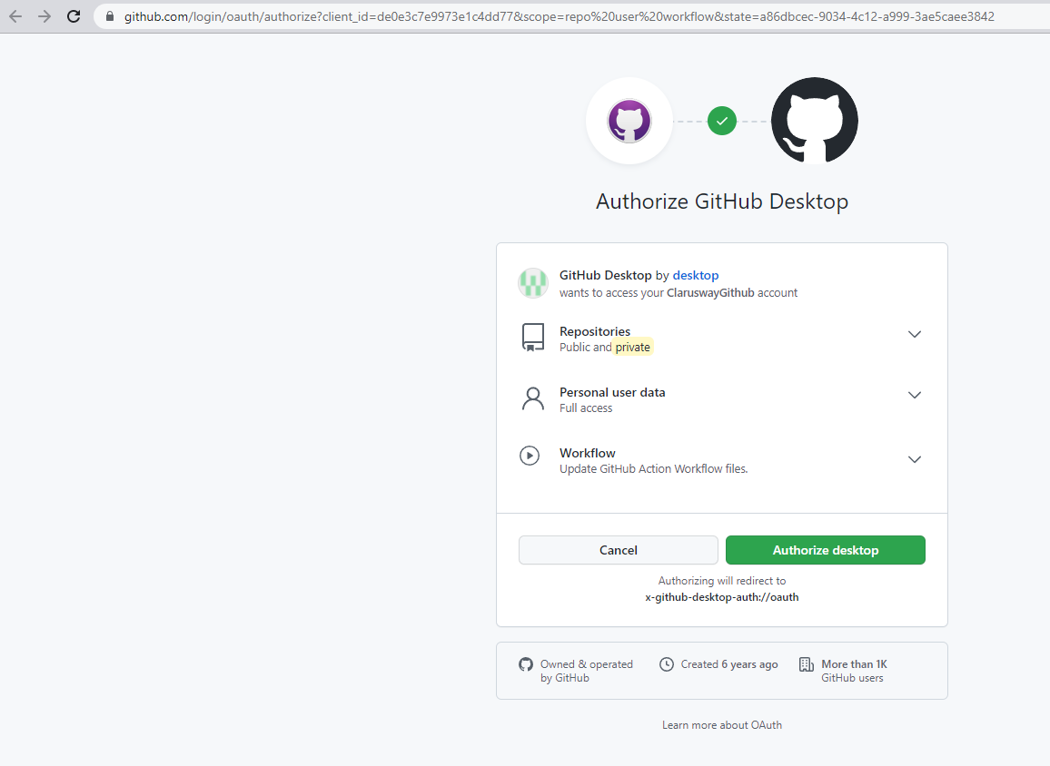
GitHub Desktop
Notes:
It’s necessary to authorize Github Desktop application just like any other Git UI tool.

Slide 43
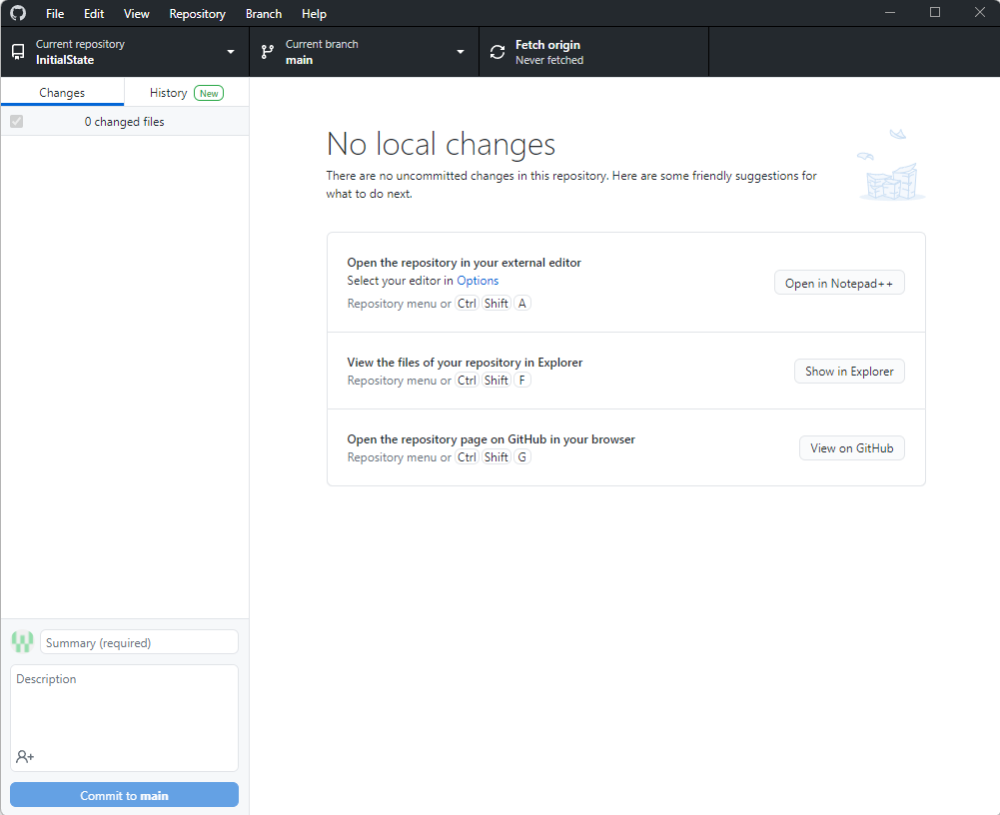
GitHub Desktop
Notes:
Clone a local repository to a local folder.

Slide 44
GitKraken Overview
https://www.gitkraken.com/download

Slide 45
GitKraken Overview
https://www.gitkraken.com/download

Slide 46
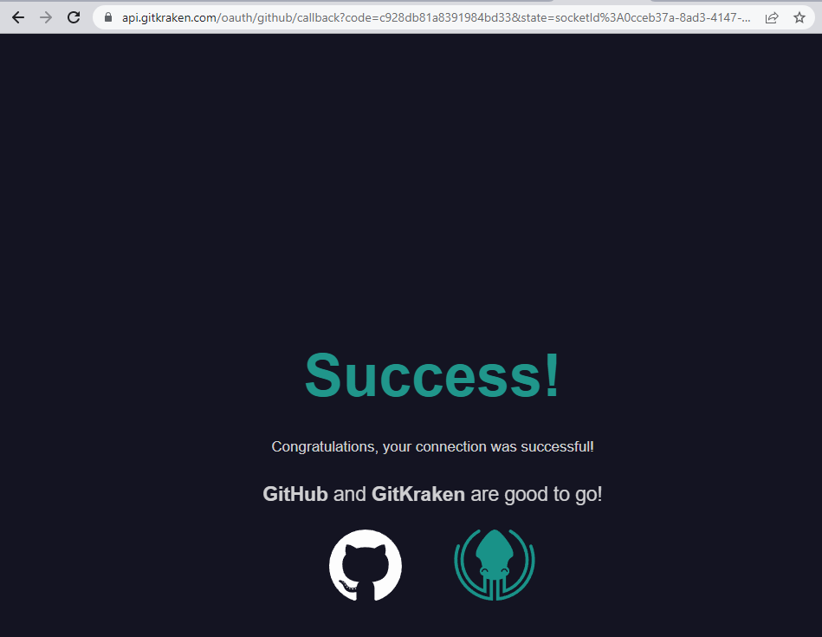
GitKraken Overview
Notes:
Authorize GitKraken.

Slide 47
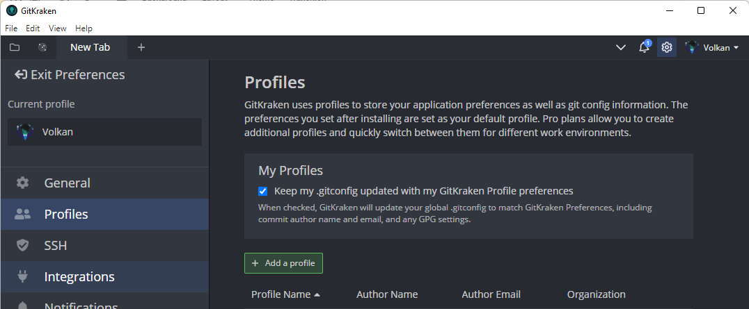
GitKraken Overview
Notes:
How do we create a profile.

Slide 48
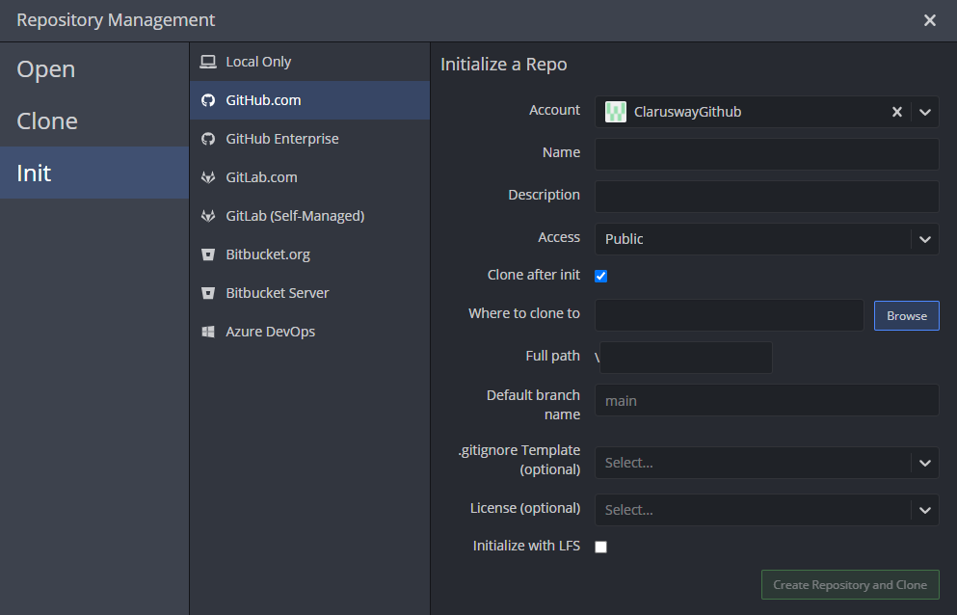
GitKraken Overview
Notes:
Initialize a repository with GitKraken.

Slide 49
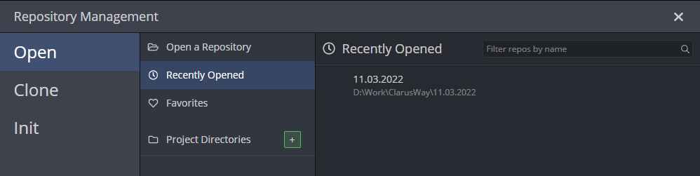
GitKraken Overview
Notes:
Open an existing repository.

Slide 50
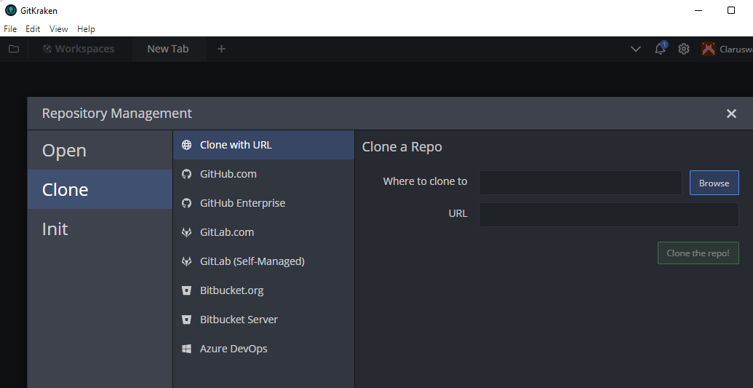
GitKraken Overview
Notes:
Clone a repository to a local path.

Slide 51
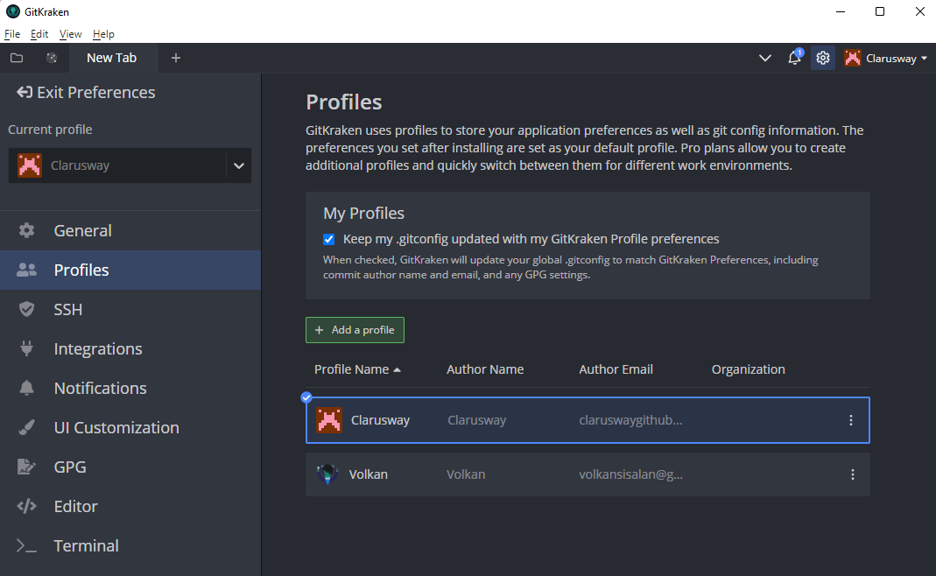
GitKraken Overview
Notes:
Switching between profiles.

Slide 52
Git Session3

Slide 53




What’s Version Control?
Time
Day - 1
Day - 2
Day - 3
reference_letter
reference_letter
resume
resume
resume
kbaşsfdkbvşkdjkhvşkhvmkhv*
kbaşsfdkbvşkdjkhvşkhvmkhv*
kbaşsfdkbvşkdjkhvşkhvmkhvkk
kbaşsfdkbvşkdjkhvşkhvmkhvkk
kbaşsfdkbvşkdjkhvşkhvmkhv*
Your
folder
Add “about” section to resume
Create “reference letter” file
Add photo and change layout
resume.doc
modified
reference_letter.doc
created
resume.doc
modified
VCS
Add “education” section to resume
resume.doc
modified

Slide 54
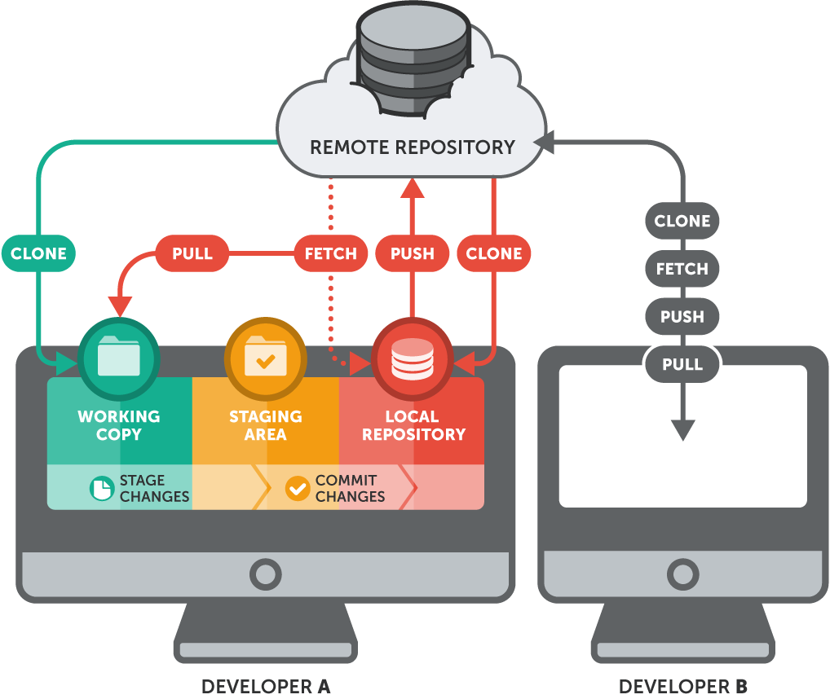
Git Basics
GitHub

Slide 55
Local Git operations
will talk about next session
Local Machine
GitHub
git init
git status
git add .
git rm -cached fileXX
git commit -m “abc”
git log
git checkout
Working directory
Staging area (index)
Git repository
Remote Git repository
git add
git commit
git checkout
Notes:
Let’s start with cloning.
Let’s create a new repo and put a new file on it. Do our first commit.
mkdir gitprojects
499 cd gitprojects/
500 git clone https://github.com/clarusway/labb.git
501 ls
502 git ls
503 ls
504 cd labb
505 ls
506 vim file2.txt
507 git status
508 git add .
509 git commit -m "mee"
510 git s
511 git push origin master
Secondly give them the link of your code and show fork. change it.
Then show them to clone again. remote to remote and then clone.
Scenario: git clone, change the file on remote, git status, git fetch, git merge
then do the same thing with git pull.
change 1 file and try to push before pull see the problem. git pull
Visual representation
Create a commit and push
create a branch and push
local: merge the branch
push
git commit
git commit
git push origin master
git pull
Fetched 0 commits on master.
Already up-to-date.
git fetch
Fetched 0 commits on master.
git branch eric
git push
Everything up-to-date.
git checkout eric
git commit
git commit
git push origin eric
git checkout master
git merge eric
You have performed a fast-forward merge.
git push origin master
Remote visual representation:
git push origin master
Push rejected. Non fast-forward. Try pulling first
git pull
Fetched 0 commits on master.
Fetched 1 commits on feature.
Fast-forwarded to origin/feature.
git commit
git commit
git push origin feature
git checkout master
git merge feature
git push

Slide 56
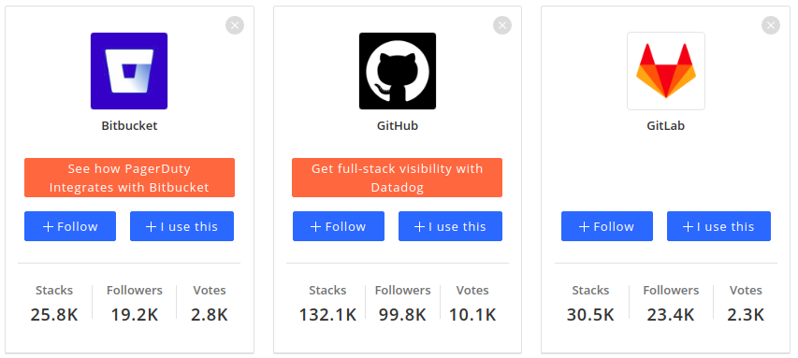
Github - Remote Repository

Slide 57
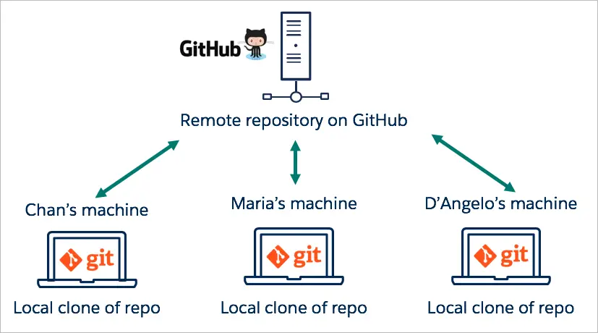
Github - Remote Repository
(default name - origin)

Slide 58
Github - Remote Repository
Act of copying a repository from remote server to your local machine is called cloning
Cloning allows team to work together
Downloading commits from others : fetch, merge
Downloading commits from others : pull (fetch + merge)
Uploading your commits (local changes) to remote : push
Notes:
Let’s start with cloning.
Let’s create a new repo and put a new file on it. Do our first commit.
mkdir gitprojects
499 cd gitprojects/
500 git clone https://github.com/clarusway/labb.git
501 ls
502 git ls
503 ls
504 cd labb
505 ls
506 vim file2.txt
507 git status
508 git add .
509 git commit -m "mee"
510 git s
511 git push origin master
The git fetch command downloads all branches, tags, and data from a project to the local machine. Existing local code is not overwritten. Fetch is commonly used with the git reset command to bring a local repository up to date with a remote repository
Secondly give them the link of your code and show fork. change it.
Then show them to clone again. remote to remote and then clone.
Scenario: git clone, change the file on remote, git status, git fetch, git merge
then do the same thing with git pull.
change 1 file and try to push before pull see the problem. git pull
Visual representation
Create a commit and push
create a branch and push
local: merge the branch
push
git commit
git commit
git push origin master
git pull
Fetched 0 commits on master.
Already up-to-date.
git fetch
Fetched 0 commits on master.
git branch eric
git push
Everything up-to-date.
git checkout eric
git commit
git commit
git push origin eric
git checkout master
git merge eric
You have performed a fast-forward merge.
git push origin master
Remote visual representation:
git push origin master
Push rejected. Non fast-forward. Try pulling first
git pull
Fetched 0 commits on master.
Fetched 1 commits on feature.
Fast-forwarded to origin/feature.
git commit
git commit
git push origin feature
git checkout master
git merge feature
git push

Slide 59
Connecting your local with remote
connect to remote repo
git remote add origin Repo address t
origin = alias for your repo address
first push
git push -u origin master t
remove remote origin
git remote rm origin t
Notes:
Everybody has a Github account right?
Origin is an alias to the remote repository.
We say origin so we won't have to write out the URL of the remote repo every time in the future.
While origin is the name most people use, you can name it something else.
-u is short for --set-upstream and adds an upstream (tracking) reference so in the future,
Git will remember where we want to push to and pull from.
That will allow us to use git pull or git push without having to specify extra arguments.
If this is the first time pushing to the remote server, you should be asked to login with your username and password.

Slide 60
Gitignore file usage
How do we use .gitignore file?
How to include multiple files?
How to include folders?
How to include files with specific extensions?
Create some files and folders in your local repository.
Create some files with .log extension and exclude them.
Demonstrate how to exclude .log files from add, see the result with status command.
Notes:
You may think about using Atom editor.
Data.log file should be individually excluded.
/dir2 should be individually excluded.
*.log should be excluded and demonstrated.

Slide 61
Git stash command
git stash save
Save modified and staged changes
git stash list
list stack-order of stashed file changes
git stash pop
write working from top of stash stack
git stash drop
discard the changes from top of stash stack
git stash clear
clear the entire stash
Notes:
Make an experiment about the stash command.

Slide 62
Github - Remote Repository
Working directory
Staging area (index)
Git repository
Remote Git repository
git add
git commit
git push
git checkout
git fetch
git pull

Slide 63
How collaborators communicate?
feature-2
Mike
master
Jane
feature-1
Time

Slide 64
How collaborators communicate?
feature-1
Mike
master
Forked repository
Mike doesn’t write access to Jane’s repository
Propose changes
master
Jane
Public open-source repository
Time

Slide 65
Github - Pull Request
Github’s feature not Git’s feature
It allows you to contribute to other projects

Slide 66
Github - Pull Request
Pull Requests (PR) let you tell others about changes you've pushed to a branch in a repository on GitHub
You create a pull request to propose and collaborate on changes to a repository. These changes are proposed in a branch, which ensures that the master branch only contains finished and approved work.

Slide 67
Why “pull” request?
Remote
Mike
Jane
Tom
Ok. Let me pull and check it!
Hey guys, İ have finalized development of the new feature. Could you please pull remote changes and have a look at it?

Slide 68



Github - Pull Request process
Mike
Creates new local branch
Commits changes to feature-1 locally
Mike is happy with changes and feature works as expected
Pushes changes to remote by creating remote feature-1 branch
Creates pull request to start review process by other collaborators
Mike requests Jane to review newly opened pull request
feature-1
commit
😊
feature-1
Time
Jane
Jane starts review of the Mike’s pull request
Optionally pulls updates and checkouts feature-1 branch to verfy how new feature works.
Add some comments for specific blocks of code and asks for changes
comments
Notes:
Pull Request ile ilgili senaryo.
Live representation.
remote origin/upstream -
Merge, rebase, conflicts
Cherry pick

Slide 69

Github - Pull Request process
Mike
Mike is notified about comments and requested changes
Makes additional changes requested by Jane
Pushes changes to remote
commit
Jane
Time
Jane is notified about new commits
Happy with new changes and approves pull request
😊
Mike
Merges changes from the feature-1 branch to the main master or release branch
Closes pull request and deletes feature-1 branch
New feature implemented !
Notes:
Pull Request ile ilgili senaryo.
Live representation.
remote origin/upstream -
Merge, rebase, conflicts
Cherry pick

Slide 70
Kahoot
General Git Quiz
Notes:
https://create.kahoot.it/details/dde75c01-0e51-4a0c-bf80-94a0d3b5d32c

Slide 71
Git
Repo, Commit, Branch, Head
What comes to you your mind when you hear this?
Notes:
🍐 This is a Pear Deck Text Slide
🍐 To edit the type of question, go back to the "Ask Students a Question" in the Pear Deck sidebar.
The HEAD points out the last commit in the current checkout branch. It is like a pointer to any reference. The HEAD can be understood as the "current branch." When you switch branches with 'checkout,' the HEAD is transferred to the new branch.

Slide 72

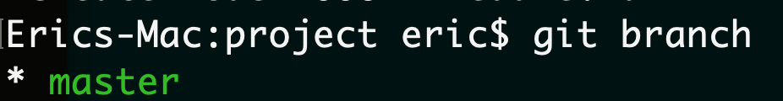
Branches
Production of the project lives on master branch
Branches are reference to a commit
Notes:
Here's an example of how Git branches are useful.
Let's say you need to work on a new feature for a website.
You create a new branch and start working.
You haven't finished your new feature, but you get a request to make a rush change that needs to go live on the site today.
You switch back to the master branch, make the change, and push it live.
Then you can switch back to your new feature branch and finish your work.
When you're done, you merge the new feature branch into the master branch,
and both the new feature and rush change are kept!
Why do we use branches? Only the final work should be on master branch.
All the work we do should be on seperate branches until it’s ready.

Slide 73
Branches
to see local branches
git branch t
to see remote branches
git branch -r t
to see all branches
git branch -a t

Slide 74
Creating/switching branches
create a new branch
git branch Branch name t
switch to a branch
git checkout Branch name t
create a new branch and switch to that branch
git checkout -b Branch name t
Notes:
http://git-school.github.io/visualizing-git/
Let’s practice visually.
Scenario 1:
I have master branch and creating a new branch and do some experiment on it. but i didn’t like it and i want to go back to master. And delete eric branch since I wont use it what happens? when i do new commit where it goes?
git commit
git commit
git checkout -b test
git commit
git commit
git commit
git checkout main
git branch -d test
git commit
Scenario 2:
We created a new branch and we liked the changes. we want to merge
git commit
git commit
git checkout -b eric
git commit
git commit
git commit
git checkout main
git merge eric
You have performed a fast-forward merge.

Slide 75
Deleting branches
delete a local branch
git branch -d Branch name t
git branch -D Branch name t
merge a branch
git merge Branch name t
Notes:
The -d option only deletes the branch if it has already been merged.
The -D option is a shortcut for --delete --force, which deletes the branch irrespective of its merged status.
Visualizing Git- Show branches
Scenario1: go back to a commit and create a new branch from there.
git checkout 551c4bd
git checkout -b test
git commit
git commit
git commit
git commit
git checkout main
git commit
git commit
git merge test
git checkout test2
git branch -d test
git checkout main
git commit
Scenario2: delete the branch before merging with -d (Do it on your computer not visually)
it will give you an error.
Once you’re done with the feature you can merge back into master

Slide 76
Connecting your local with remote
connect to remote repo
git remote add origin Repo address t
origin = alias for your repo address
first push
git push -u origin master t
remove remote origin
git remote rm origin t
Notes:
Everybody has a Github account right?
Origin is an alias to the remote repository.
We say origin so we won't have to write out the URL of the remote repo every time in the future.
While origin is the name most people use, you can name it something else.
-u is short for --set-upstream and adds an upstream (tracking) reference so in the future,
Git will remember where we want to push to and pull from.
That will allow us to use git pull or git push without having to specify extra arguments.
If this is the first time pushing to the remote server, you should be asked to login with your username and password.

Slide 77
Github - Remote Repository
Act of copying a repository from remote server to your local machine is called cloning
Cloning allows team to work together
Downloading commits from others : fetch, merge
Downloading commits from others : pull (fetch + merge)
Uploading your commits (local changes) to remote : push
Copying from remote to remote : fork
Notes:
Let’s start with cloning.
Let’s create a new repo and put a new file on it. Do our first commit.
mkdir gitprojects
499 cd gitprojects/
500 git clone https://github.com/clarusway/labb.git
501 ls
502 git ls
503 ls
504 cd labb
505 ls
506 vim file2.txt
507 git status
508 git add .
509 git commit -m "mee"
510 git s
511 git push origin master
Secondly give them the link of your code and show fork. change it.
Then show them to clone again. remote to remote and then clone.
Scenario: git clone, change the file on remote, git status, git fetch, git merge
then do the same thing with git pull.
change 1 file and try to push before pull see the problem. git pull
Visual representation
Create a commit and push
create a branch and push
local: merge the branch
push
git commit
git commit
git push origin master
git pull
Fetched 0 commits on master.
Already up-to-date.
git fetch
Fetched 0 commits on master.
git branch eric
git push
Everything up-to-date.
git checkout eric
git commit
git commit
git push origin eric
git checkout master
git merge eric
You have performed a fast-forward merge.
git push origin master
Remote visual representation:
git push origin master
Push rejected. Non fast-forward. Try pulling first
git pull
Fetched 0 commits on master.
Fetched 1 commits on feature.
Fast-forwarded to origin/feature.
git commit
git commit
git push origin feature
git checkout master
git merge feature
git push

Slide 78
Kahoot
Git and Github terminology
Notes:
https://create.kahoot.it/details/ea694993-f7e0-4915-995f-399df7becc52

Slide 79
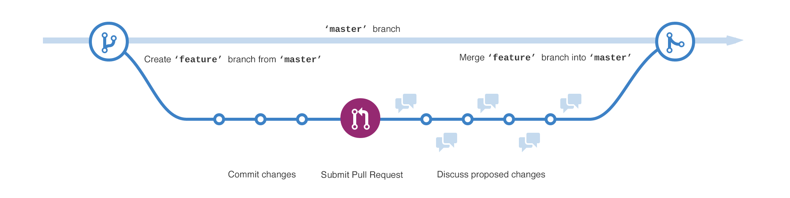
Github - Merge
You merge a pull request into the upstream branch when work is completed. Anyone with push access to the repository can complete the merge.
Notes:
Pull Request ile ilgili senaryo.
Live representation.
remote origin/upstream -
Merge, rebase, conflicts
Cherry pick

Slide 80
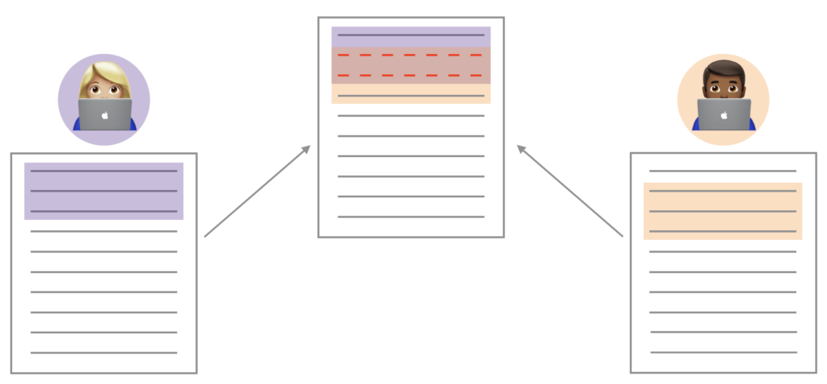
Github - Merge Conflict
Merge conflicts happen when you merge branches that have competing commits, and GitHub needs your help to decide which changes to incorporate in the final merge.
Notes:
Pull Request ile ilgili senaryo.
Live representation.
remote origin/upstream -
Merge, rebase, conflicts
Cherry pick

Slide 81
Merge - Rebase
merge a branch
git merge Branch name t
rebase a branch
git rebase Branch name t
Notes:
From a content perspective, rebasing is changing the base of your branch from one commit to
another making it appear as if you'd created your branch from a different commit.

Slide 82
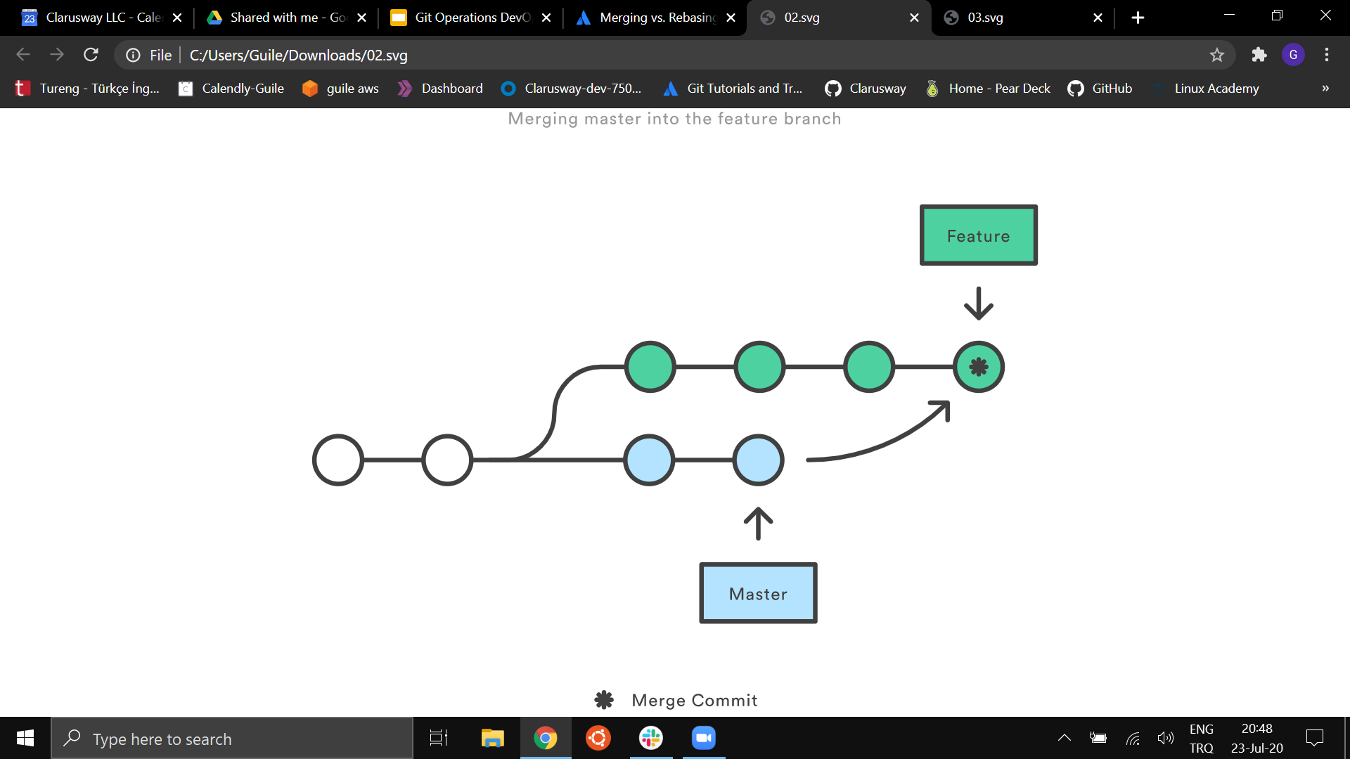
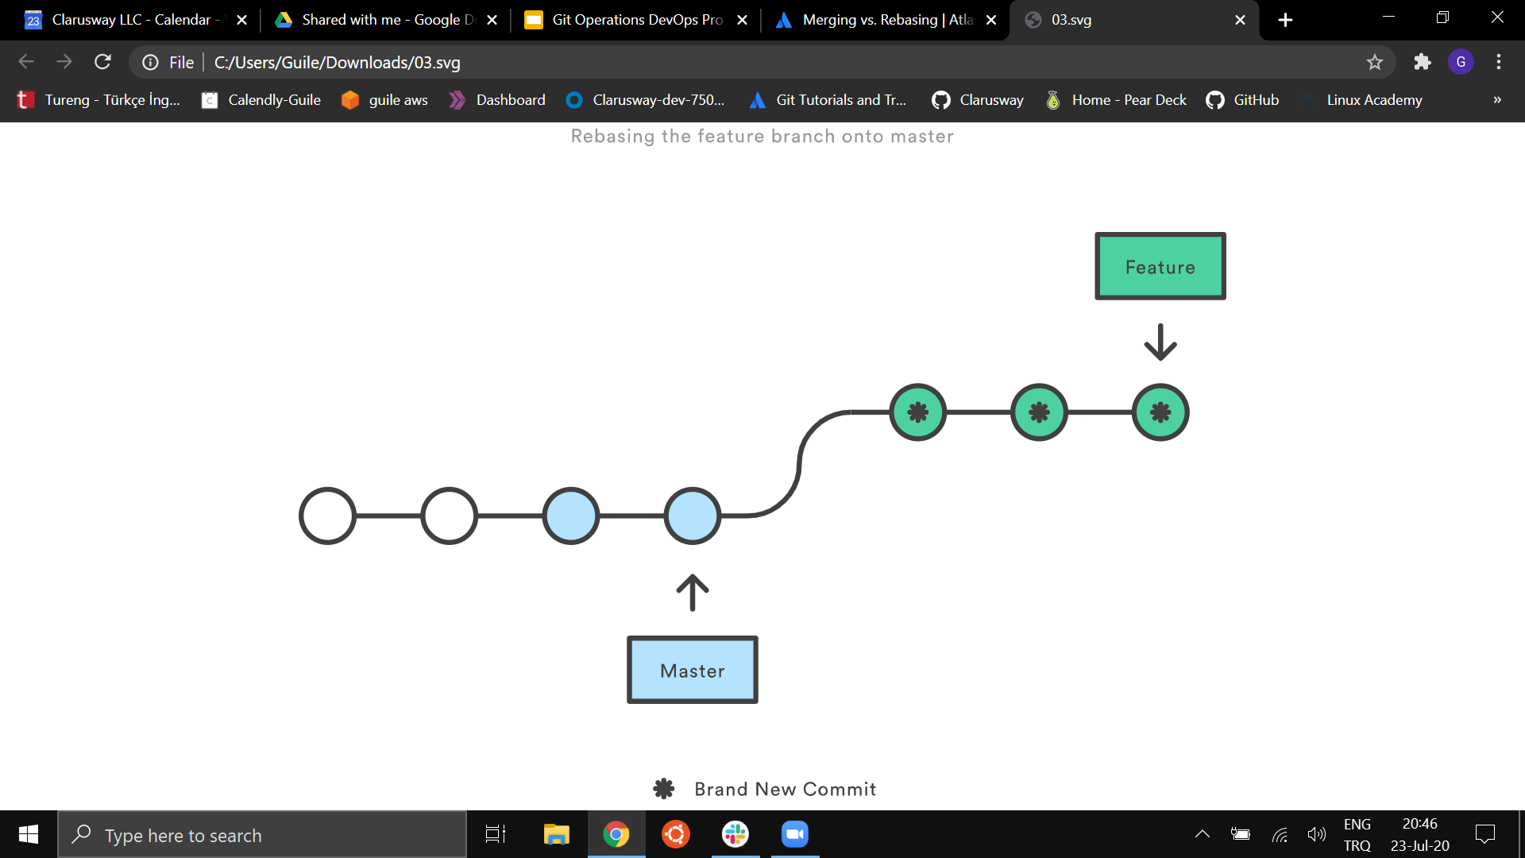
Merge - Rebase
merge a branch
rebase a branch
Notes:
From a content perspective, rebasing is changing the base of your branch from one commit to another
making it appear as if you'd created your branch from a different commit.
Internally, Git accomplishes this by creating new commits and applying them to the specified base.
Rebasing is often used as an alternative to merging.
Rebasing a branch updates one branch with another by applying the commits
of one branch on top of the commits of another branch.
For example, if working on a feature branch that is out of date with a dev branch,
rebasing the feature branch onto dev will allow all the new commits from dev to be included in feature.
Here’s what this looks like visually:
git rebase feature dev

Slide 83
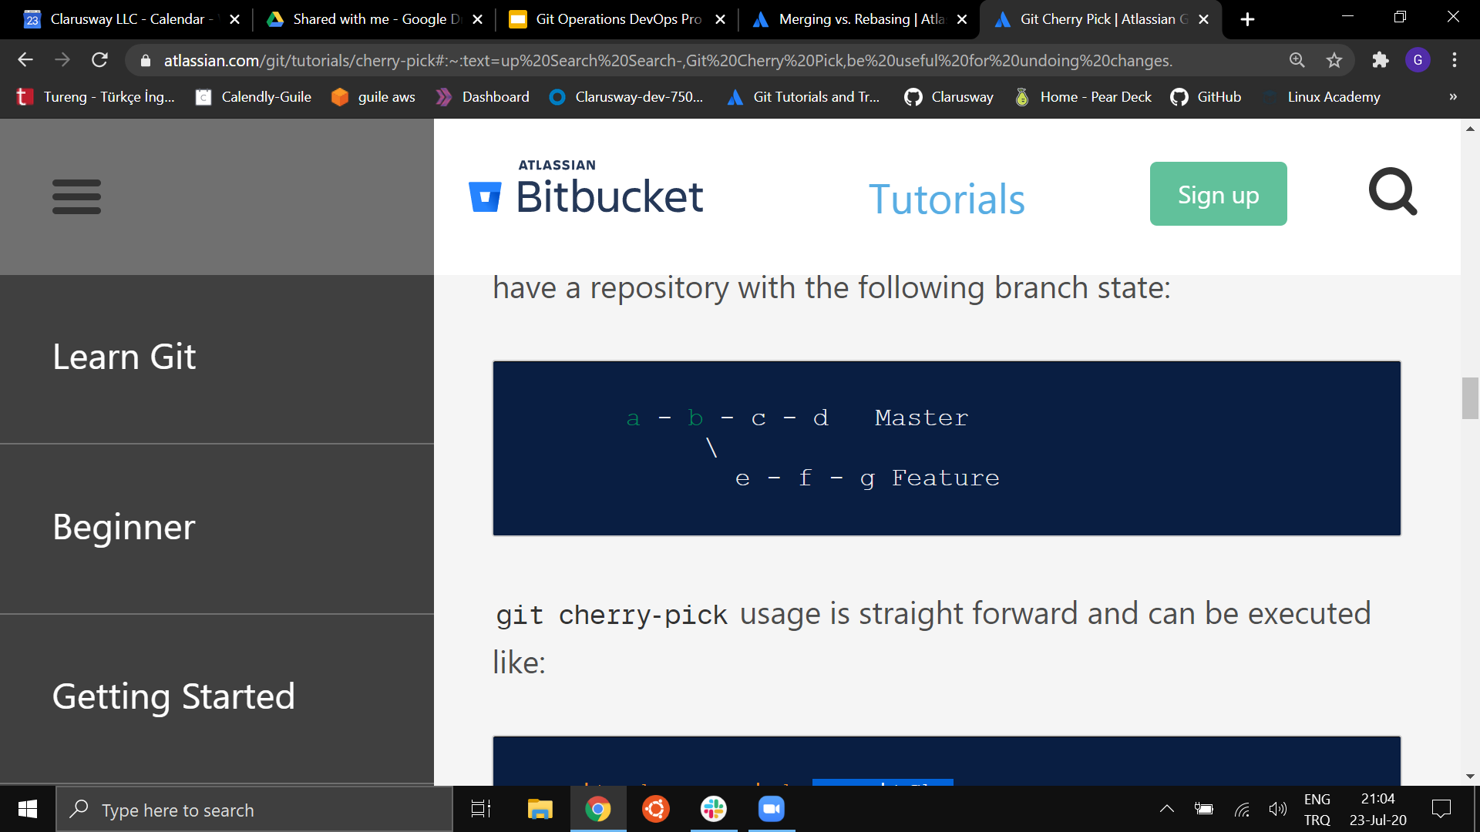
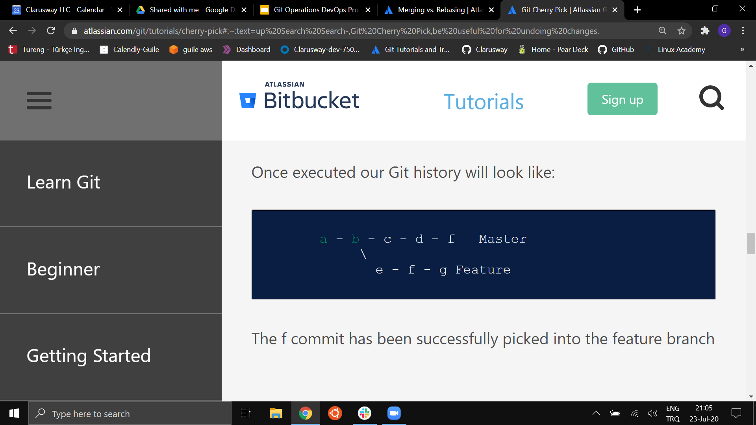
Cherry Pick
git cherry-pick commitSha t
git cherry-pick f
Notes:
Cherry picking in Git means to choose a commit from one branch and apply it onto another.
Cherry picking in Git means to choose a commit from one branch and apply it onto another.
This is in contrast with other ways such as merge and rebase which normally apply many commits onto another branch.
Make sure you are on the branch you want to apply the commit to. git switch master
Execute the following: git cherry-pick <commit-hash>

Slide 84
Git
Branch, Head
What comes to you your mind when you hear this?
Notes:
🍐 This is a Pear Deck Text Slide
🍐 To edit the type of question, go back to the "Ask Students a Question" in the Pear Deck sidebar.
Today no coding,
Pre-class, what did you learn about Git?
The HEAD points out the last commit in the current checkout branch.
It is like a pointer to any reference.
The HEAD can be understood as the "current branch."
When you switch branches with 'checkout,' the HEAD is transferred to the new branch.

Slide 85
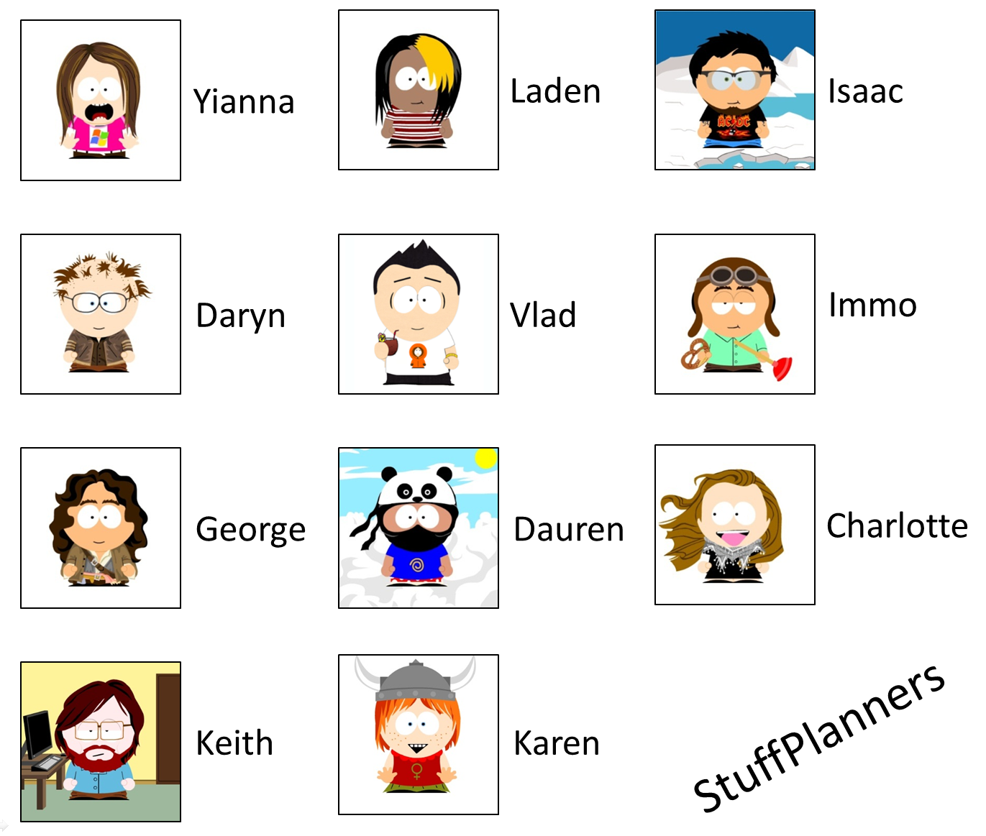
Git Branches
History Tracking
Spelling correction
Feature description
Create document
Company logo
Grammar fix
Color change
T i m e a n d V e r s i o n s
Notes:
git checkout 0d1d7fc32
If we drew a picture of the activities of you working on one of those files that we just described,
you might for each of the points in time describe what you did to the file, why you changed it,
and then you'd like the tool itself to record. what the contents of that change were, from one word to another.
a spelling correction, the change of a color or a background, or adding a company logo to the top of a webpage or even a Word document.
For a single individual, this doesn't seem too hard, and for a single file, it seems relatively straightforward.
Many individual products are putting this into the product themselves, this idea of keeping a history.

Slide 86

Git Branches
Collaborative History Tracking
Spelling correction
Feature description
Create documnet
Company logo
Grammar fix
Color change
T i m e a n d V e r s i o n s
Notes:
For a single individual, I repeat, this is again rather straightforward and rather simple.
But where Git really shines is when we start talking about this in the collaborative sense:
you and other team members trying to do the same thing. even worse: on the same files.
When you do that, you need something much more capable than a simple revision history of
a single file for a single person. You need the idea of keeping track of who changed it, when they changed it, why they changed it.
but the capability of the tool to unify these back together in what is typically referred to as a merge.
These actions, these interleavings of you and the team members working on the same, similar, or adjacent files is handled adeptly by a full-fledged version control system like that of Git.

Slide 87
Git Branches
Git Branches
Collaborative History Tracking
T i m e a n d V e r s i o n s

Slide 88
Git Branches
Collaboration
Task 1
+
Task 2
+
Task 2
Combined Tasks

Slide 89
Branches
Production of the project lives on master/main branch
Branches are reference to a commit
Notes:
Here's an example of how Git branches are useful.
Let's say you need to work on a new feature for a website.
You create a new branch and start working.
You haven't finished your new feature, but you get a request to make a rush change that needs to go live on the site today.
You switch back to the master branch, make the change, and push it live.
Then you can switch back to your new feature branch and finish your work.
When you're done, you merge the new feature branch into the master branch, and both the new feature and rush change are kept!
Why do we use branches? Only the final work should be on master branch. All the work we do should be on seperate branches until it’s ready.

Slide 90
Branches
to see local branches
git branch t
to see remote branches
git branch -r t
to see all branches
git branch -a t

Slide 91
Creating/switching branches
create a new branch
git branch Branch name t
switch to a branch
git checkout Branch name t
create a new branch and switch to that branch
git checkout -b Branch name t
Notes:
http://git-school.github.io/visualizing-git/
Let’s practice visually.
Scenario 1:
I have master branch and creating a new branch and do some experiment on it. but i didn’t like it and i want to go back to master. And delete eric branch since I wont use it what happens? when i do new commit where it goes?
git commit
git commit
git checkout -b eric
git commit
git commit
git commit
git checkout master
git branch -d eric
git commit
Scenario 2:
We created a new branch and we liked the changes. we want to merge
git commit
git commit
git checkout -b eric
git commit
git commit
git commit
git checkout master
git merge eric
You have performed a fast-forward merge.

Slide 92
Deleting branches
delete a local branch
git branch -d Branch name t
git branch -D Branch name t
Notes:
The -d option only deletes the branch if it has already been merged. The -D option is a shortcut for --delete --force, which deletes the branch irrespective of its merged status.
Visualizing Git- Show branches
Scenario1: go back to a commit and create a new branch from there.
git checkout 551c4bd
git checkout -b raymon
git commit
git commit
git commit
git commit
git checkout master
git commit
git commit
git merge raymon
git checkout eric
git branch -d raymon
git checkout master
git commit
Scenario2: delete the branch before merging with -d (Do it on your computer not visually)
it will give you an error.
Once you’re done with the feature you can merge back into master

Slide 93
Bonobo Git Server
Lets install Bonobo Git Server on a specific server and publish it.
Notes:
Download the zip file
Unarchive the zip file
Copy the contents of the zip file folder to “c:\inetpub\wwwroot”
Change the security properties of the app_data folder to allow modify access to the IIS user
Check anonymous authentication is enabled
Visit Http://localhost/bonobo.git.server
Create a user
Amend settings to “allow user repository creation” and “allow push to create repositories”
Create a repo
Push repo to your server

Slide 94
Merge Conflicts
Same files were edited in both branches
HEAD
master
Root
commit
Ancestor
feature-1
Time

Slide 95
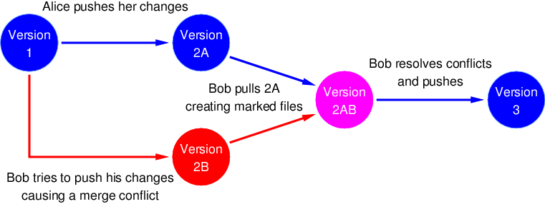
Merge Conflicts
Merge conflicts happen when you merge branches that have competing commits, and Git needs your help to decide which changes to incorporate in the final merge.
Same files were edited in both branches

Slide 96
Github - Merge Conflict
Merge conflicts happen when you merge branches that have competing commits, and Git needs your help to decide which changes to incorporate in the final merge.
Notes:
Pull Request ile ilgili senaryo.
Live representation.
remote origin/upstream -
Merge, rebase, conflicts
Cherry pick

Slide 97
Github - Pull Request
Github’s feature not Git’s feature
It allows you to contribute to other projects
Notes:
Pull Request ile ilgili senaryo.
Live representation.
remote origin/upstream -
Merge, rebase, conflicts
Cherry pick

Slide 98
Github - Pull Request
Pull Requests (PR) let you tell others about changes you've pushed to a branch in a repository on GitHub
You create a pull request to propose and collaborate on changes to a repository. These changes are proposed in a branch, which ensures that the master branch only contains finished and approved work.
Notes:
Pull Request ile ilgili senaryo.
Live representation.
remote origin/upstream -
Merge, rebase, conflicts
Cherry pick

Slide 99
How collaborators communicate?
feature-2
Mike
master
Jane
feature-1
Time

Slide 100
Why “pull” request?
Remote
Mike
Jane
Tom
Ok. Let me pull and check it!
Hey guys, İ have finalized development of the new feature. Could you please pull remote changes and have a look at it?

Slide 101
How collaborators communicate?
feature-1
Mike
master
Forked repository
Mike doesn’t write access to Jane’s repository
Propose changes
master
Jane
Public open-source repositıry
Time

Slide 102
Github - Pull Request process
Mike
Creates new local branch
Commits changes to feature-1 locally
Mike is happy with changes and feature works as expected
Pushes changes to remote by creating remote feature-1 branch
Creates pull request to start review process by other collaborators
Mike requests Jane to review newly opened pull request
feature-1
commit
😊
feature-1
Time
Jane
Jane starts review of the Mike’s pull request
Optionally pulls updates and checkouts feature-1 branch to verfy how new feature works.
Add some comments for specific blocks of code and asks for changes
comments
Notes:
Pull Request ile ilgili senaryo.
Live representation.
remote origin/upstream -
Merge, rebase, conflicts
Cherry pick

Slide 103
Github - Pull Request process
Mike
Mike is notified about comments and requested changes
Makes additional changes requested by Jane
Pushes changes to remote
commit
Jane
Time
Jane is notified about new commits
Happy with new changes and approves pull request
😊
Mike
Merges changes from the feature-1 branch to the main master or release branch
Closes pull request and deletes feature-1 branch
New feature implemented !
Notes:
Pull Request ile ilgili senaryo.
Live representation.
remote origin/upstream -
Merge, rebase, conflicts
Cherry pick

Slide 104
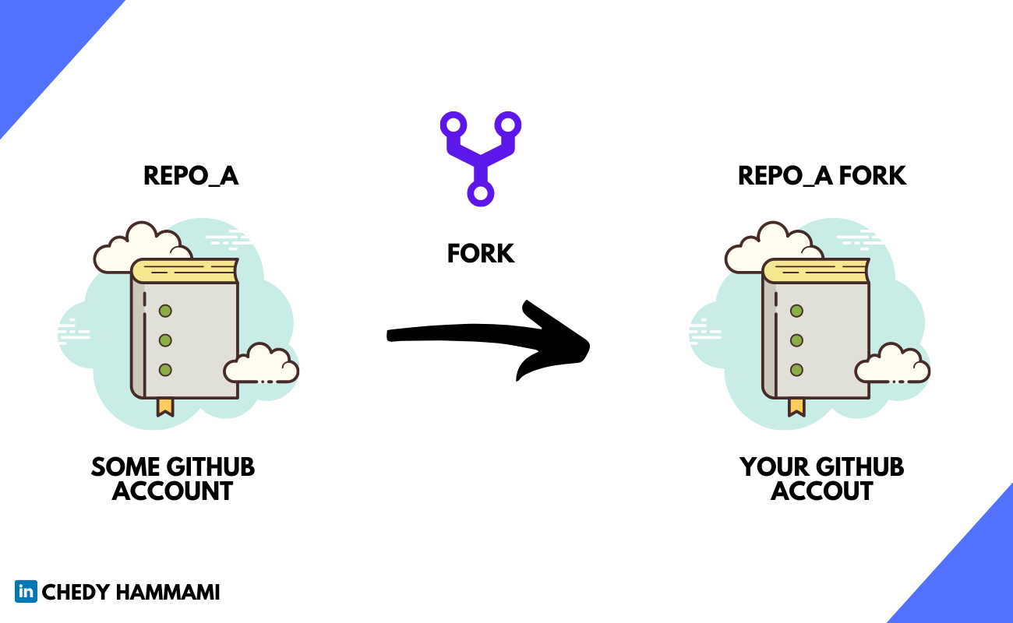
Github - Fork
A fork is a copy of a repository.
Notes:
A fork is a copy of a repository. Forking a repository allows you to freely experiment with changes without affecting the original project.
Most commonly, forks are used to either propose changes to someone else's project or to use someone else's project as a starting point for your own idea.

Slide 105
Git Session4
Notes:
Branches
Switching between branches
Deleting branches
Comparing Commits
We’ll make practice, only some slides and we are done.
Dont forget to view updates in GITHUB DESKTOP in every step

Slide 106
Recap-Branches
git branch branch_name
git branch
git branch -a
git checkout branch_name
git checkout -b branch_name
git branch -d branch_name
git branch -D branch_name
git merge branch_name

Slide 107
Fast forward merge
Fast forward merge is possible when there are no further commits in the receiving branch after the commit where feature branch was created
HEAD
master
Root
commit
feature-1
Time

Slide 108
Fast forward merge
git merge <feature-branch>
HEAD
Root
commit
master
feature-1
Time

Slide 109
3-way merge
HEAD
master
Root
commit
Ancestor
feature-1
Time

Slide 110
3-way merge
HEAD
master
Merge commit
Root
commit
Ancestor
feature-1
Time

Slide 111
THANKS!

